Slide 1
OFFICE OF SCHOOLS
Updated Phase II Re-Opening
Anita Williams, Chief of Schools

Slide 2
Phase II Re-Opening
COVID-19 Safety guidelines and protocols
Parent Declaration of Intent Process (December 3rd -21st)
Instructional Models
  Site based virtual
  Face-to-Face
  AVA or AVA Jr

Slide 3
Phase II Re-Opening
January 2021
Now-Through May 2021 Asynchronous Wednesdays!!!!!
January 5 Early Release (11:30) - Election Tuesday- GO VOTE!!
January 18 MLK Holiday
January 19 Teacher’s first official in-person report day- Teach virtually from school site
January 21-22 Teachers teach virtually from school site
January 25th Grades PreK-2 & Special Education (Low Incidence -PreK-12) students return to Face 2 Face Instruction & 3 - 5 have a 8:00 a.m. – 2:30 p.m. Virtual Day of Instruction
For internal use only-EMBARGOED

Slide 4
Phase II Re-Opening
Students Phased-in (Face 2 Face Instruction)
January 25th PreK-2 and Special Education (Low Incidence -PreK-12) students return to Face 2 Face
February 1st Grades 3-5, 6, 9, 10 students return to Face 2 Face
February 4th Grades 7, 8, 11, 12 students return to Face 2 Face
Traditional school hours begin January 25th for Elementary - PreK-5 including Sp. Ed. Low Incidence
School Daily Schedule
Pre-K Virtual (8-10:30) Pre-K Face to Face (8:00 a.m. - 2:30 p.m.)
Elementary: Kindergarten - Fifth Grade Virtual AND Face to Face (8:00 a.m. - 2:30 p.m.)
Traditional school hours begin January 25th for Middle and High School Special Education (Low Incidence)
Middle 9:05 a.m. – 4:05 p.m.
High 8:30 a.m. – 3:30 a.m.
Traditional school hours begin February 1st (Virtual & Face 2 Face)
Middle 9:05 a.m.- 4:05 p.m.
High 8:30 a.m.- 3:30 p.m.

Slide 5
Phase II Re-Opening
Timeline
December 2, 2020 - May 2021 Asynchronous Wednesdays
December 3-21 Intent to return window opens
January 19 Teachers return for in-person instruction-Teach virtually from school site
January 25 Grades PreK-2 and Special Education (Low Incidence PreK-12)
students return to Face 2 Face
February 1 Grades 3-5, 6, 9, 10 students return to Face to Face
February 4 Grades 7, 8, 11, 12 students return to Face to Face

Slide 6
Thank you for your support!!!

Slide 7
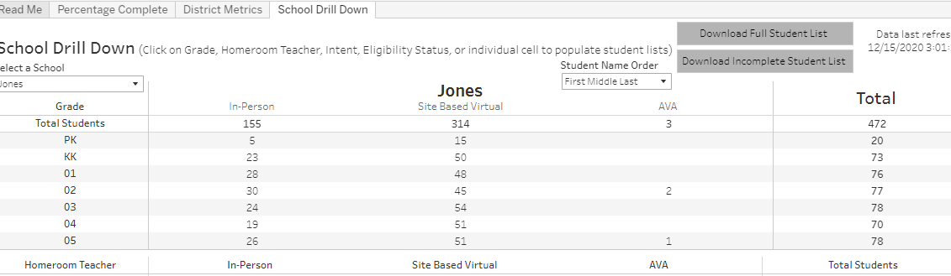
Data – Intent to Return Survey

Slide 8
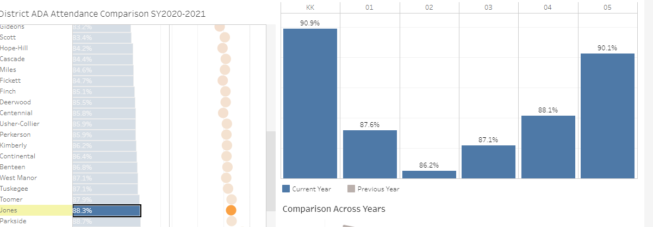
DATA - ATTENDANCE

